Slide 1
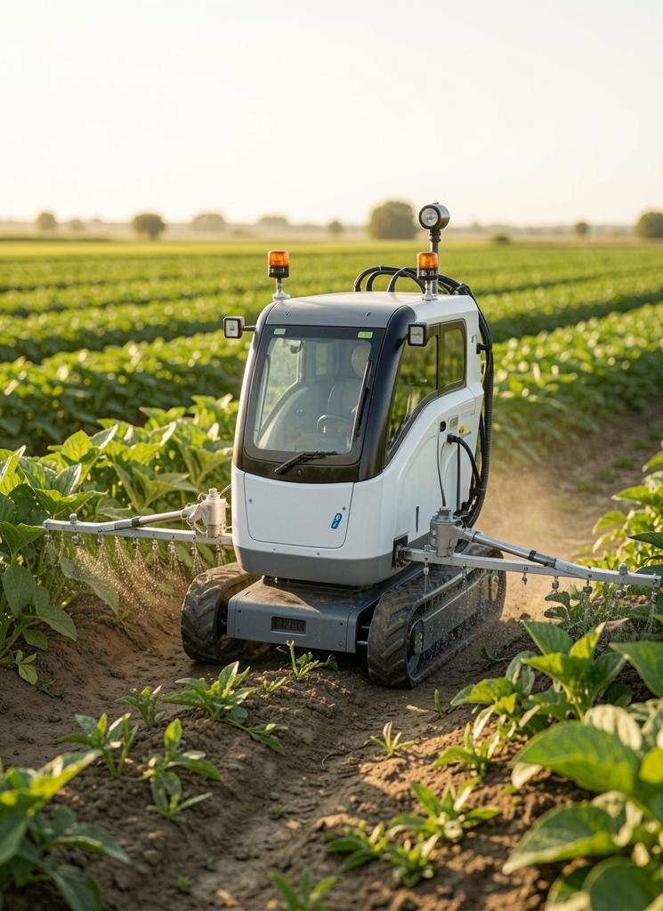
Agribot Proposal
AI-driven system for detecting nutrient deficiencies and automated spraying
yourwebsite.com
→

Slide 2
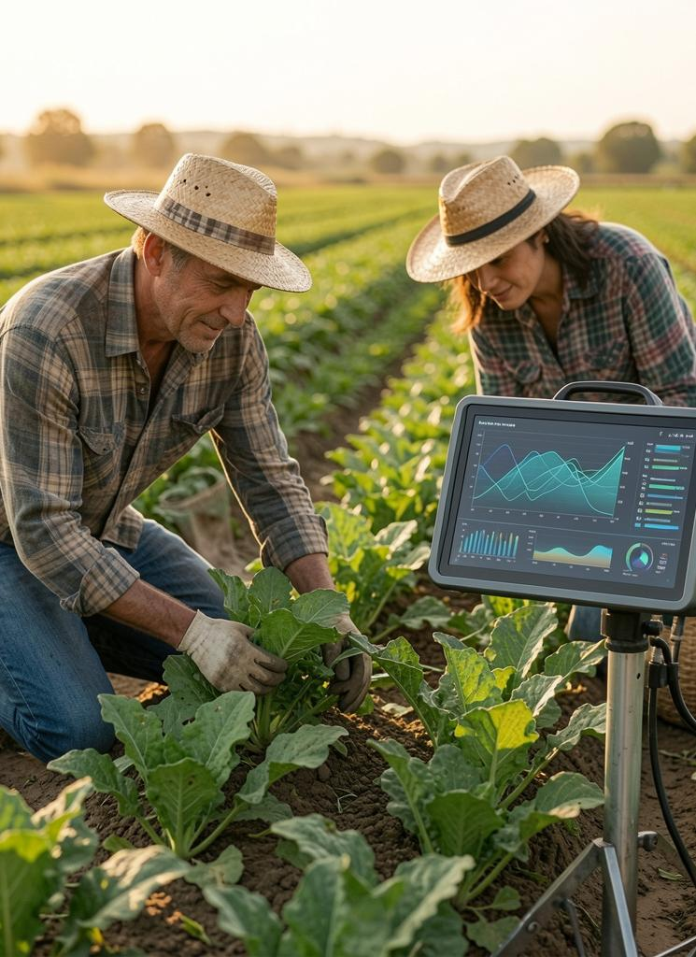
Introduction
Agriculture remains vital for Sri Lanka; early nutrient deficiency detection is challenging and labor-intensive.
This project proposes an AI-powered agribot combining computer vision and IoT to enable real-time, accurate detection and automated treatment.

Slide 3
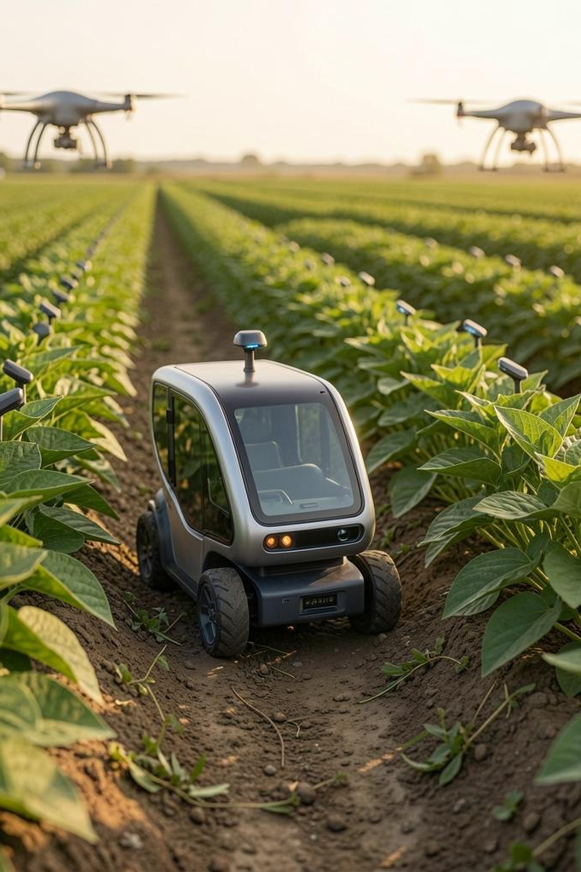
01
Project Overview

Slide 4
Introduction
The system captures plant images, classifies nutrient status with a CNN model, and triggers targeted spraying.
Key benefits: reduced labor, improved accuracy, and timely interventions for higher yields.

Slide 5
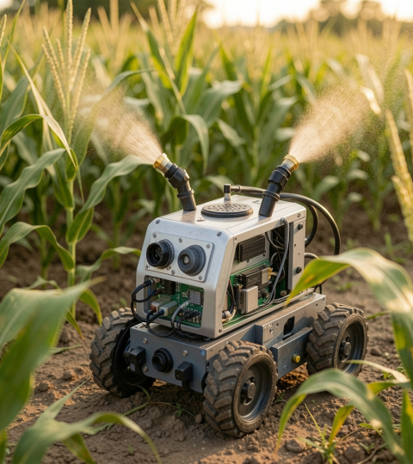
Aim & Objectives
Aim: Develop an AI-powered agribot that detects deficiencies and applies corrective sprays automatically.
Objectives: Build ESP32-based robot, train CNN classifier, integrate MQTT for monitoring, and implement a rotating nozzle spraying mechanism.

Slide 6
Expected Outcomes
Accurate real-time detection of nutrient deficiencies using computer vision, leading to timely interventions and reduced crop loss.
Automated, targeted spraying with a rotating nozzle delivers precise chemical application, lowering input waste and labor costs while improving yield.

Slide 7
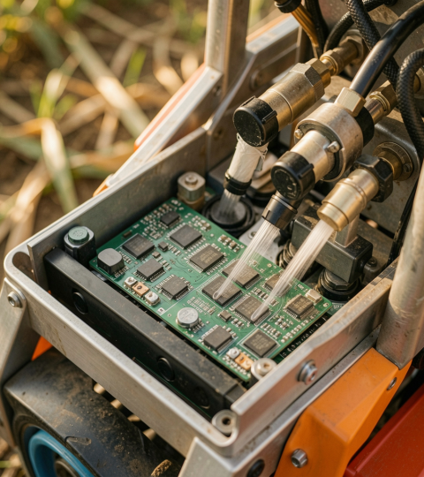
02
Technical Design

Slide 8
Hardware Components
ESP32-CAM controller, 4-wheel chassis, camera module, four liquid tanks, pumps and solenoid valves, and a servo-driven rotating nozzle.
Battery-powered system with modular sensors for scalability and field robustness.

Slide 9
AI Model Configuration
A supervised CNN classifier trained on labeled plant images to detect Healthy, Nitrogen, Phosphorus, and Potassium deficiencies.
Optimized and quantized for deployment on ESP32 for on-device inference and low latency.

Slide 10
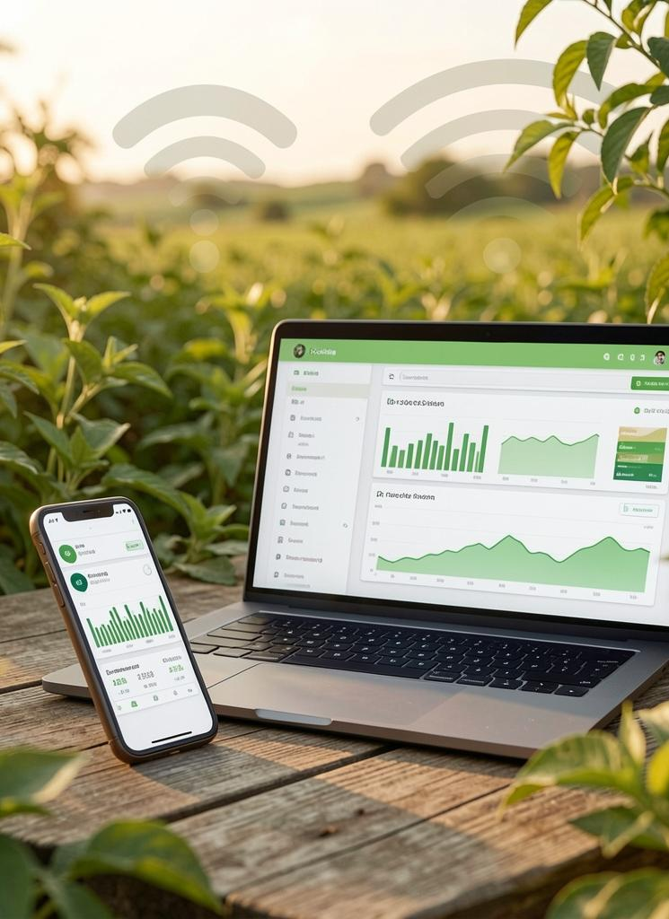
IoT Architecture
Robot publishes detection, action, and status topics via MQTT for remote monitoring and control.
Dashboard/mobile client enables real-time alerts, logs, and manual override for operational oversight.

Slide 11
Conclusions
The AI-powered agribot integrates CV, embedded AI, and IoT to deliver automated, precise nutrient management.
Expected impact: higher yields, lower costs, and scalable adoption for sustainable smart farming.

Slide 12
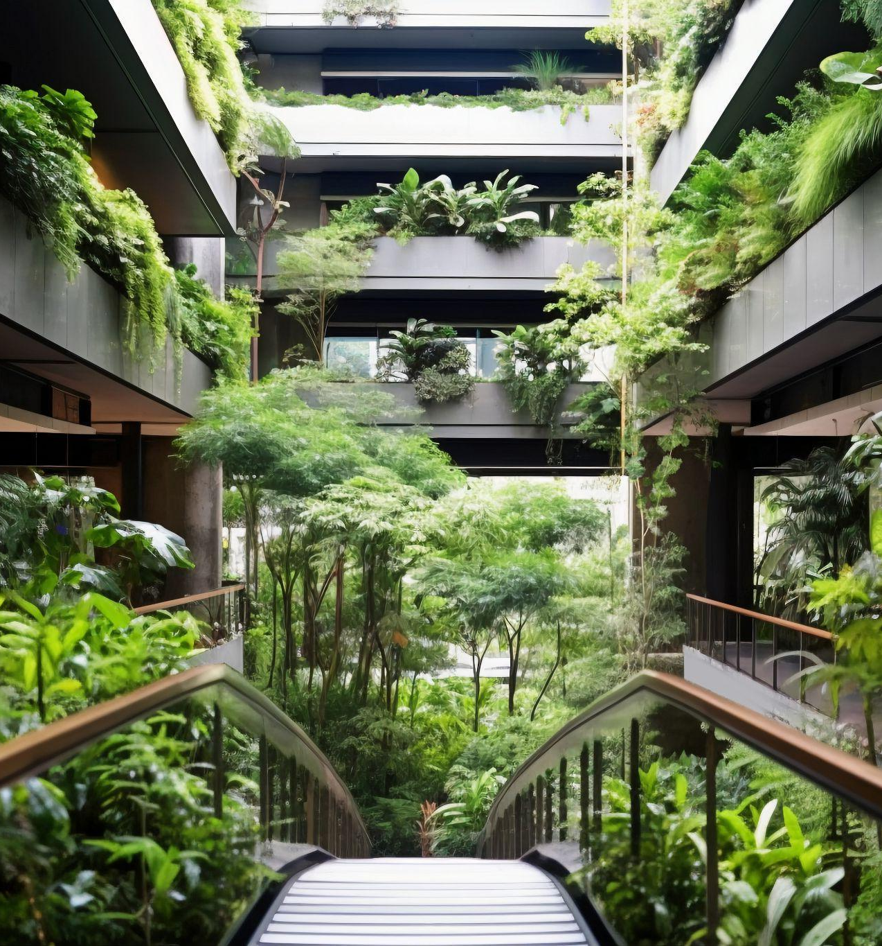
Thanks!
Do you have any questions?
youremail@freepik.com
+34 654 321 432
yourwebsite.com
↓
CREDITS: This presentation template was created by Slidesgo, and includes icons, infographics & images by Freepik
Please keep this slide for attribution

